Slide 1
RC Circuits!
Lecture 15

Slide 2
Announcements
Exam on Thursday.
Check the website
Practice exam & solutions
Seating chart
Study hard!

Slide 3
RC Demo

Slide 4
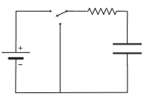
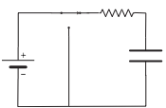
Charging: Overview of the action.

Slide 5
Charging: Overview of the action.
My capacitor heuristic:
Small t (large ν) → C is a short circuit
Large t (small ν) → C is an open circuit

Slide 6
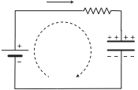
Charging: Setting up the equations
Kirchhoff Voltage Law:

Slide 7
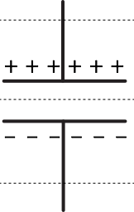
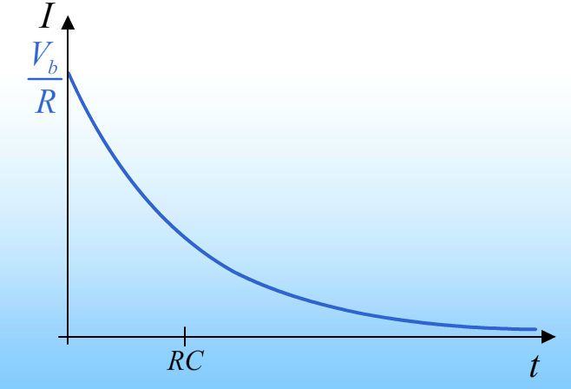
Aside: Does current really flow through a capacitor?
Current through 3 surface
The current through the gap is always 0!
“Current through the capacitor” = change in Q on plates

Slide 8
Aside: Does current really flow through a capacitor?
“Current through the capacitor” = change in Q on plates

Slide 9
Charging: Setting up the equations
Kirchhoff Voltage Law:
Initial State:

Slide 10
Charging: Solving the equations
Overhead.

Slide 11
Charging: Solution
RC time constant:

Slide 12
Quick check of the units….
RC time constant units:

Slide 13
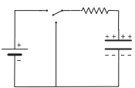
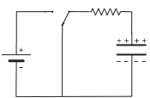
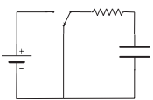
Discharging: Overview of the action.

Slide 14
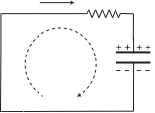
Discharging: Setting up the equations
Kirchhoff Voltage Law:
Initial State:

Slide 15
Discharging: Solution
RC time constant:

Slide 16
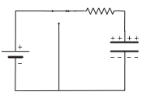
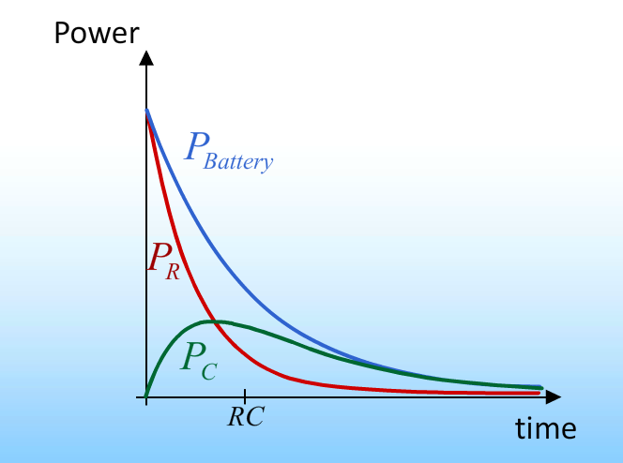
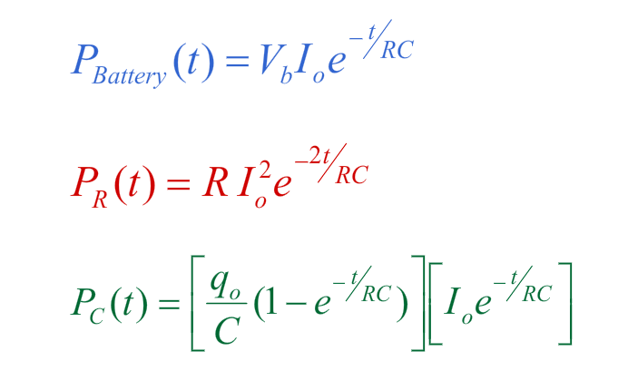
Energy flow in an RC circuit.
Power:
Energy stored:

